Slide 1
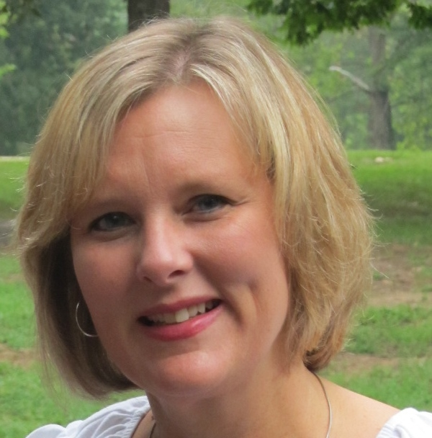
Who Is…
Debbie Parrish

Slide 2
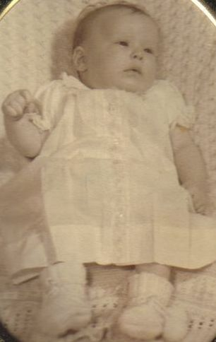
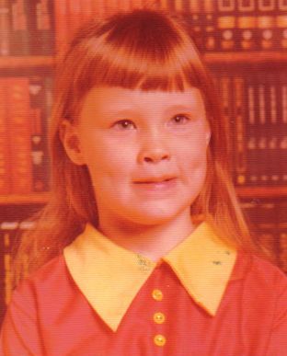

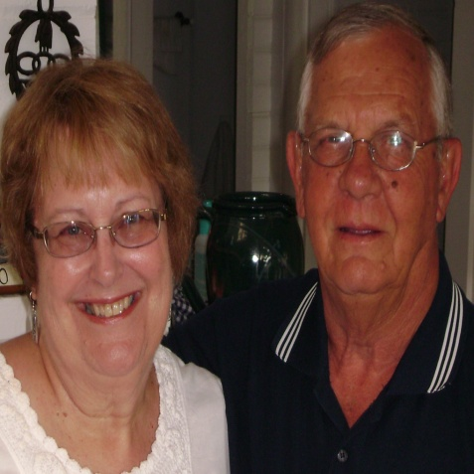
Early Life
Born in Rocky Mount, NC
Born on December 12, 1967
Parents: Wayne and Nancy Gray
Younger Brother: Rod Gray
Grew up in Henderson, NC

Slide 3
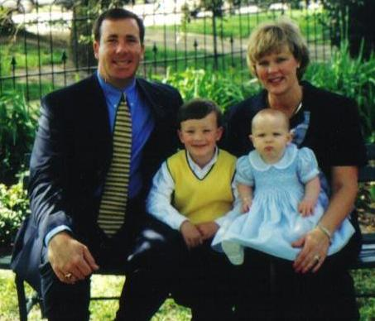

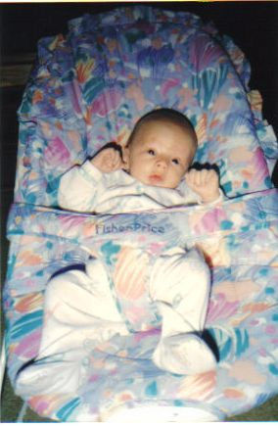
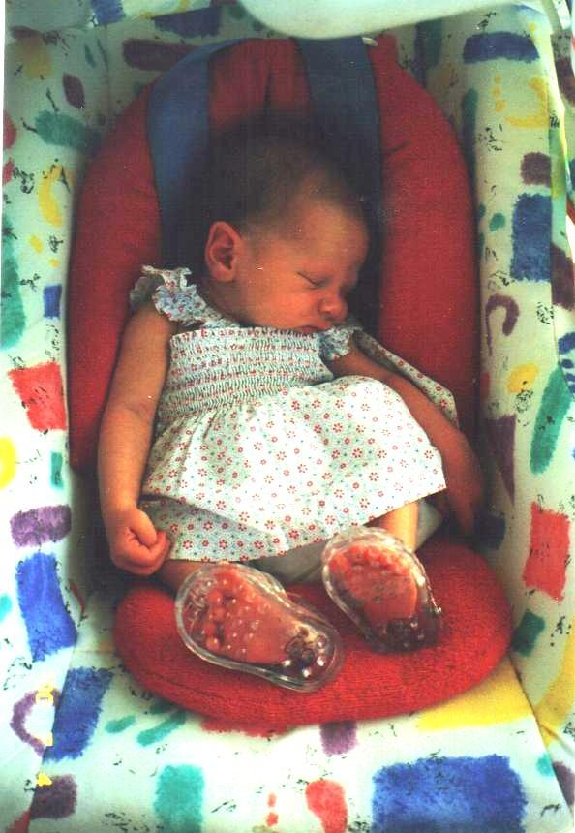
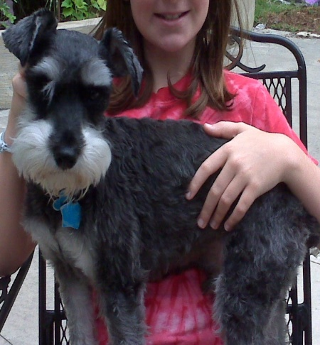
Family Life
Met John Parrish at Skateeum in 1983.
Married John Parrish on June 23, 1990.
Children: Grayson Taylor Parrish- Born on April 5, 1996
Nan Stephenson Parrish- Born on June 27, 2000
Pets: Packer, a Miniature Schnauzer

Slide 4

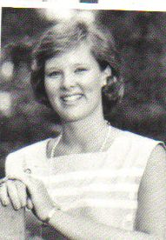


School Days
EDUCATION:
Northern Vance High School - Graduated 1986
Meredith College- Graduated 1990
BS - Child Development and Home Economics

Slide 5



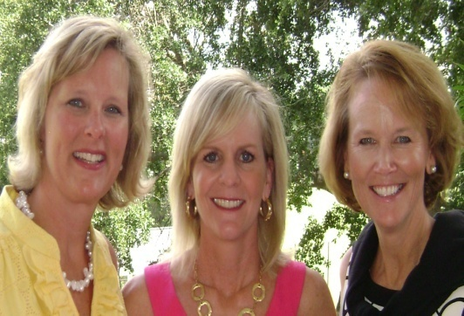
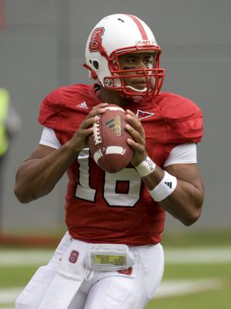



Things I Like…
Family
Friends
Volleyball
NC State Football
San Diego Chargers
Pizza
Chocolate
The Beach ~ “My favorite place”

Slide 6



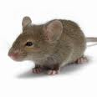
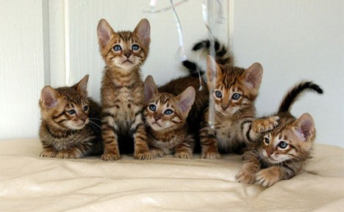

Things I Dislike…
Mice
Disney Channel
Cats
Sponge Bob
Brussel Sprouts
Cold Weather

Slide 7

Debbie Quiz
Tomorrow

